Slide 1
Home work -2
Amit
Leibniz Universität Hannover

Slide 2
The Period of simple pendulum i.e. simple harmonic motion, can be represented with the following equation:
T = 2π × √ g/l
where, g = acceleration due to gravity
l = length of the pendulum
T = time period of simple pendulum
Simulation starts with an initial sample size i.e. 1000
A python generator method i.e run() is defined to generate random values of length, angle and angular velocity for a given interval
length changes between 9.5m and 10.5m randomly (uniform)
Initial velocity changes 0.25 to 0.35 rad/sec randomly (uniform)
Initial theta changes between 55 to 65 degrees randomly (uniform)
Time period is calculated using the method TimePeriod() for each set of random values and plotted against the random input set
The language used for implementation is Python
To plot the output pyplot package is used from matplotlib library
Simple Pendulum (Monte Carlo Simulation)

Slide 3
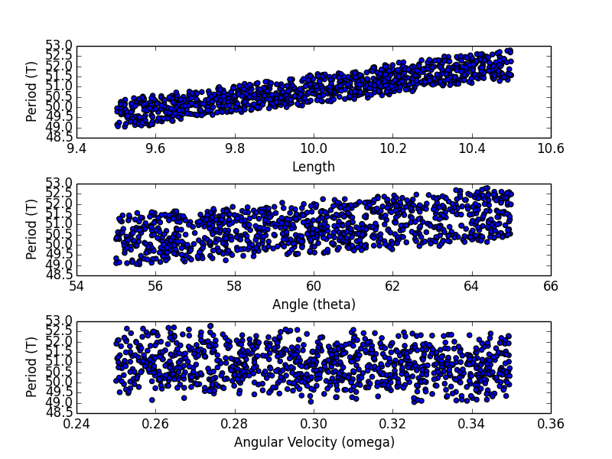
Results
(Output i.e. Time Period (T) against inputs Length, Angle, Angular Velocity )

Slide 4
The motion of simple pendulum i.e. simple harmonic motion, can be represented with the following equation:
θʺ = - (g/l) × sin(θ)
where, g = acceleration due to gravity
l = length of the pendulum
θ = angle with the rest position
θʺ = double derivative of angle (angular acceleration)
Simulation starts with initial length (fixed), initial angle (which will be changing with time) and initial value of angular velocity (changes with time)
In order to find the solution to the second order differential equation (mentioned above) Runge-Kutta fourth order method (RK4) is used
Time period is calculated using the method TimePeriod() for each set of random values and plotted against the random input set
The language used for implementation is Python
To plot the output pyplot package is used from matplotlib library
Simple Pendulum (Real Time Simulation)

Slide 5
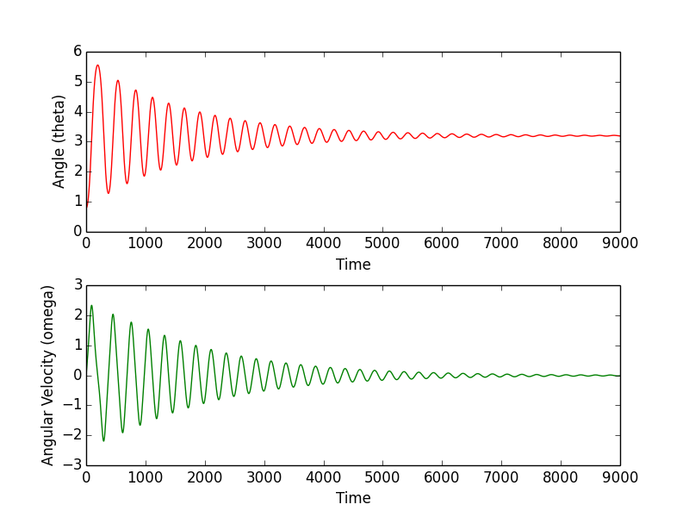
Results (Angle and Angular velocity)
Initial Values: length = 1.0, theta = pi/4, angular velocity = 0

